Slide 1


Limerick · Trondheim · Alba Iulia · Písek · Sestao · Smolyan · Võru
Co-Creation of Positive Energy Blocks
1st NordicZEB+ Conference 2019 | 07.11.2019
Dirk Ahlers | Patrick Driscoll | Håvard Wibe| Annemie Wyckmans (NTNU)
http://cityxchange.eu/
This project has received funding from the European Union’s Horizon 2020 research and innovation programme under grant agreement No 824260.

Slide 2
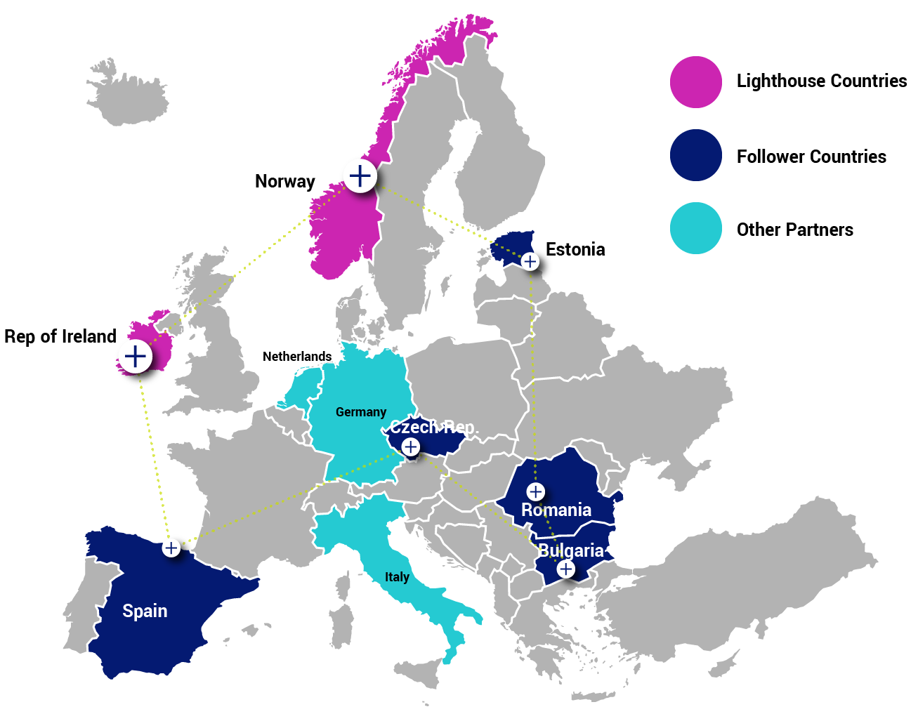
Cities

Slide 3
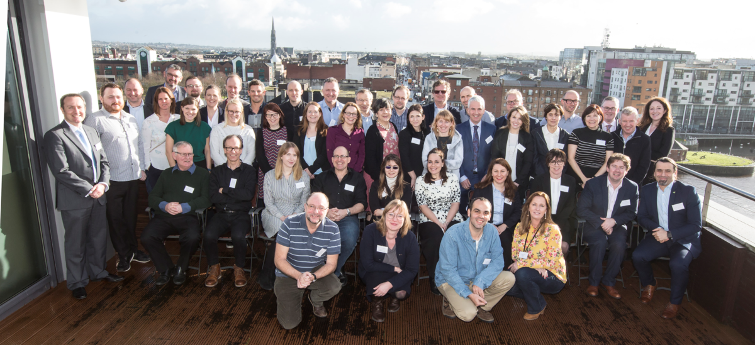
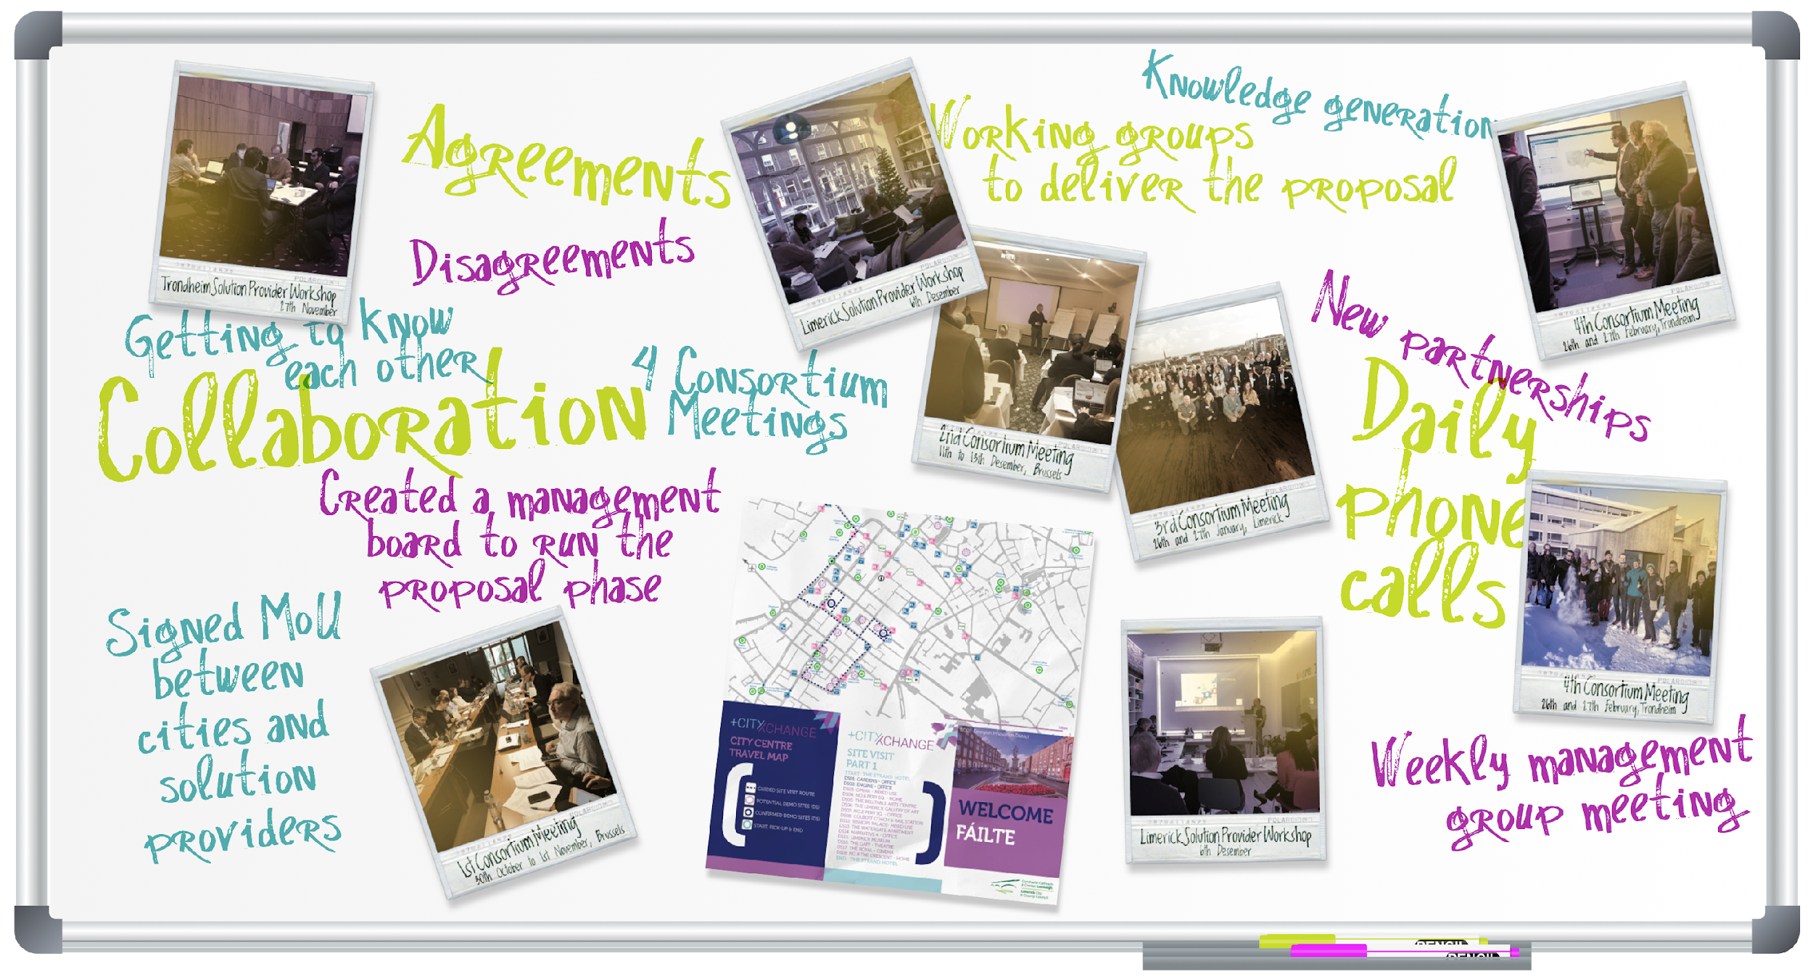
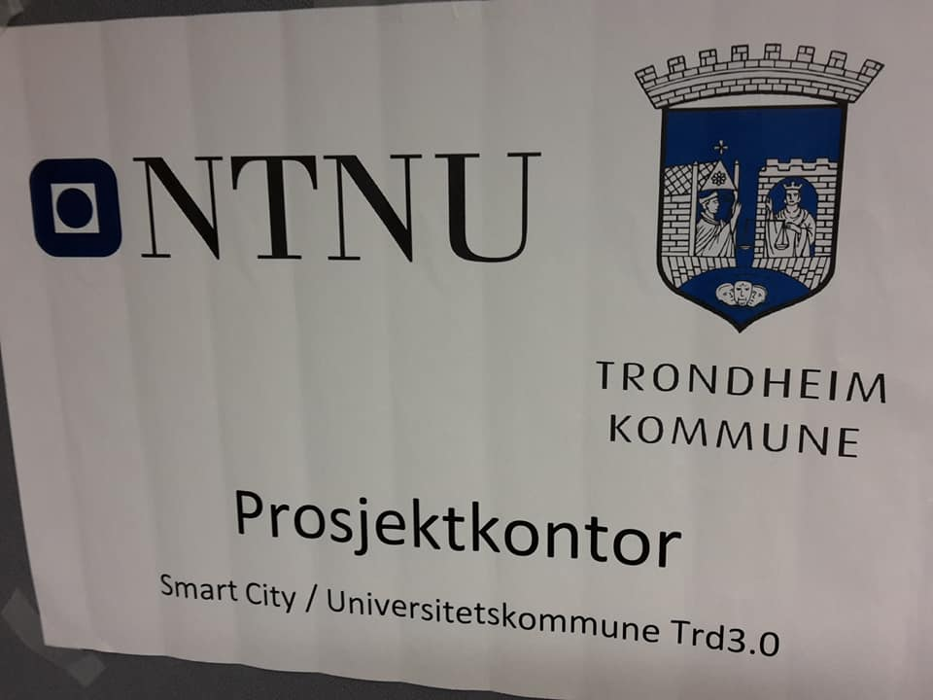
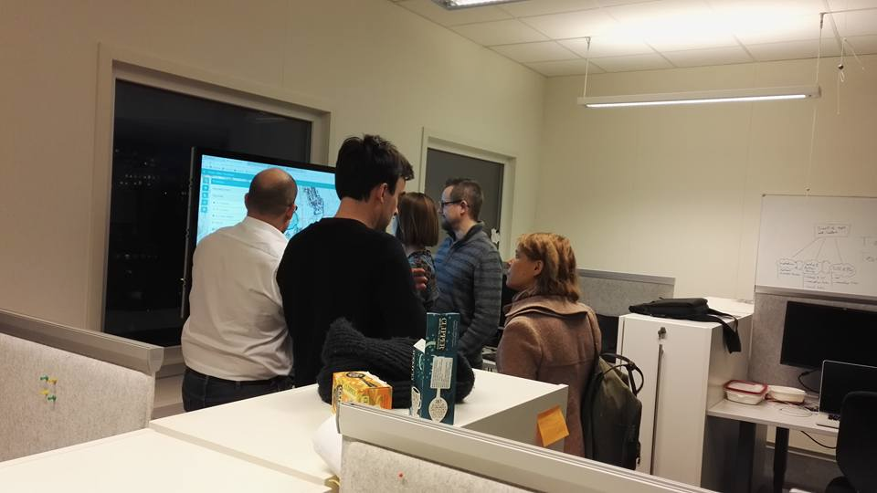
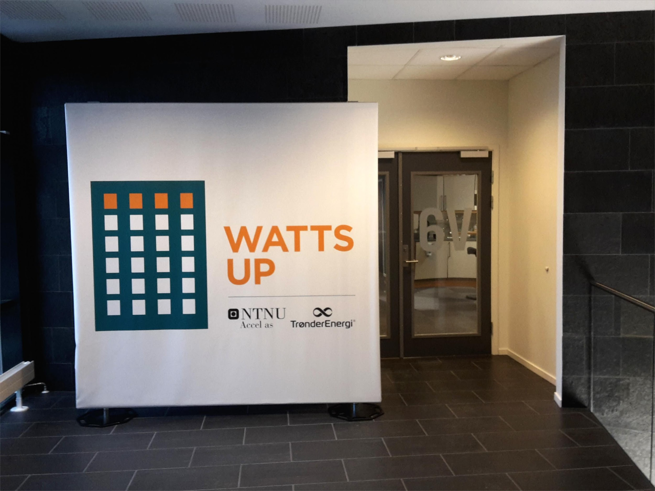
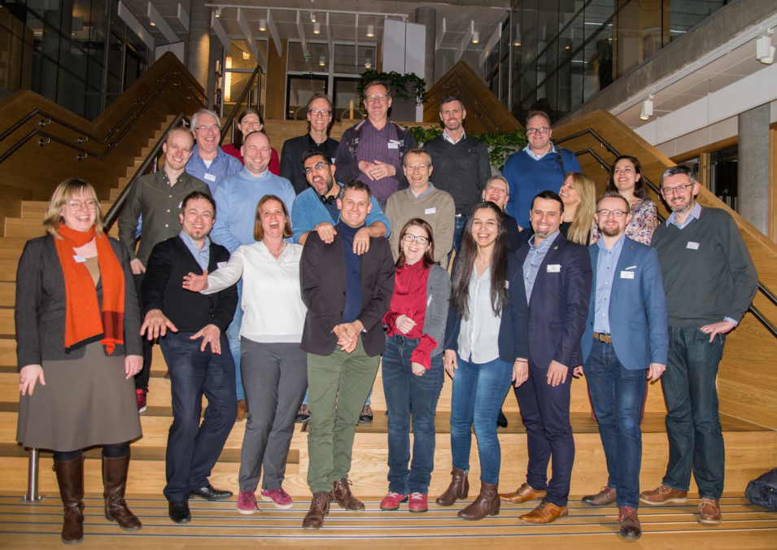
Co-creating a project
Consortium building and preparation with 32 partners

Slide 4
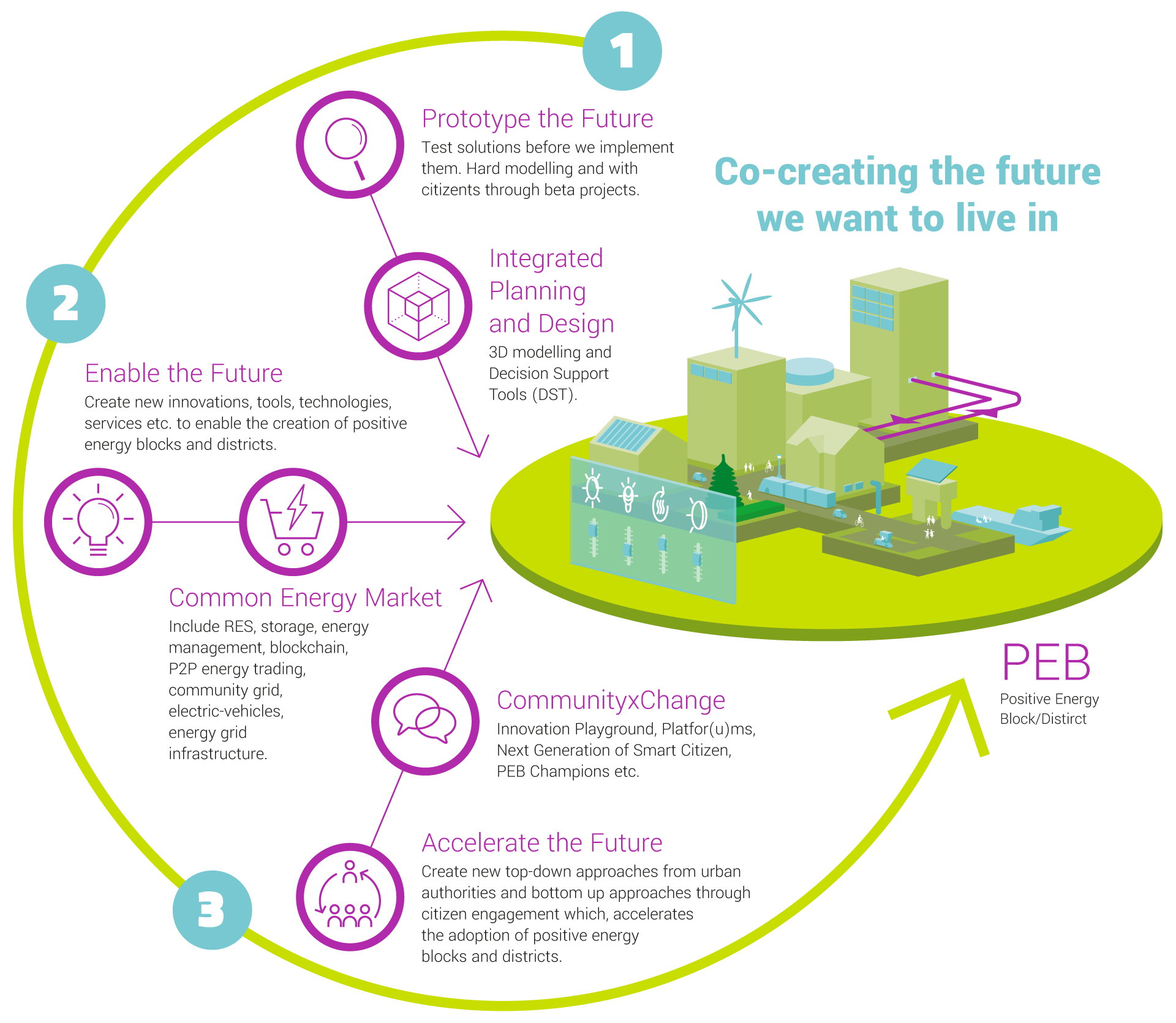
Objectives: Positive Energy Blocks and Districts (PEBs/PEDs)
Multiple buildings (new and/or retrofitted)
Active management of energy consumption and flow
Annual positive energy balance
Exchange of energy within and with the outside system
Optimal use of RES, storage, smart grid, demand-response, user interaction, ICT
Integrated and scalable design
Part of the clean energy transition

Slide 5
Co-Creation and City-Driven Transition to PEBs/PEDs

Slide 6
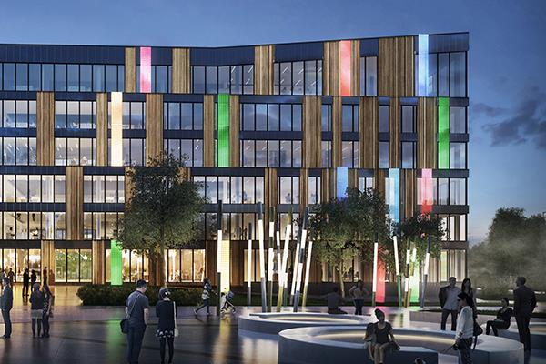
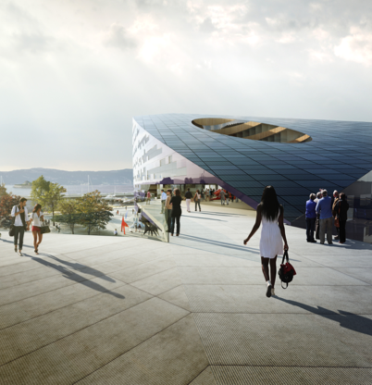
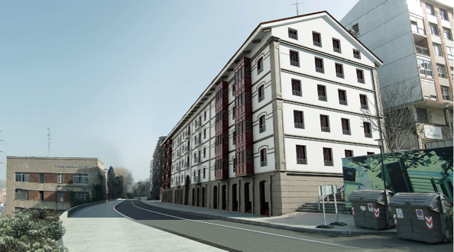
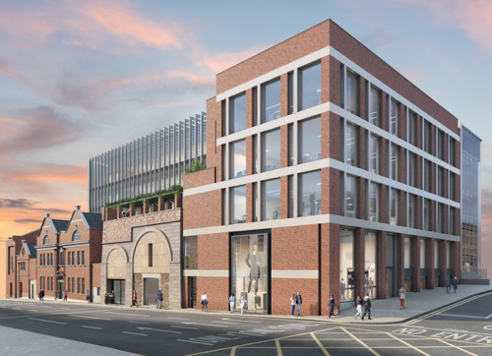
Starting from hubs
Lysgården, Sluppen, Trondheim [www.lysgarden.no]
Calle Txabarri, Sestao [www.sestaoberri.eus]
Powerhouse Brattøra, Trondheim [www.powerhouse.no]
Gardens International, Limerick [www.limerick.ie]

Slide 7




Co-Creation and Open Innovation
Citizen participation, outreach, open data and systems
“Open by Default”
Co-creation: cities + universities + solution providers + citizens; new frameworks and methodologies
“Next Generation Smart Citizen”
Creating Innovation Spaces (SCC project office + Smart City + UniversityCity + Citizen Observatory + Innovation Playgrounds + City as a living lab)

Slide 8
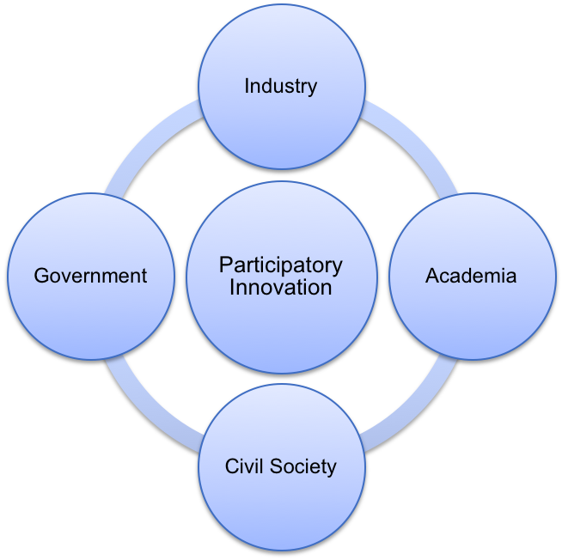
Quadruple Helix Innovation Model
Method used in Innovation, Urban Planning/Development, Citizen engagement
Co-Creation and Open Innovation
Involvement and collaboration of relevant actors
Structural changes beyond any one segment
Involvement of all stakeholders in urban innovation, knowledge sharing, collaboration

Slide 9
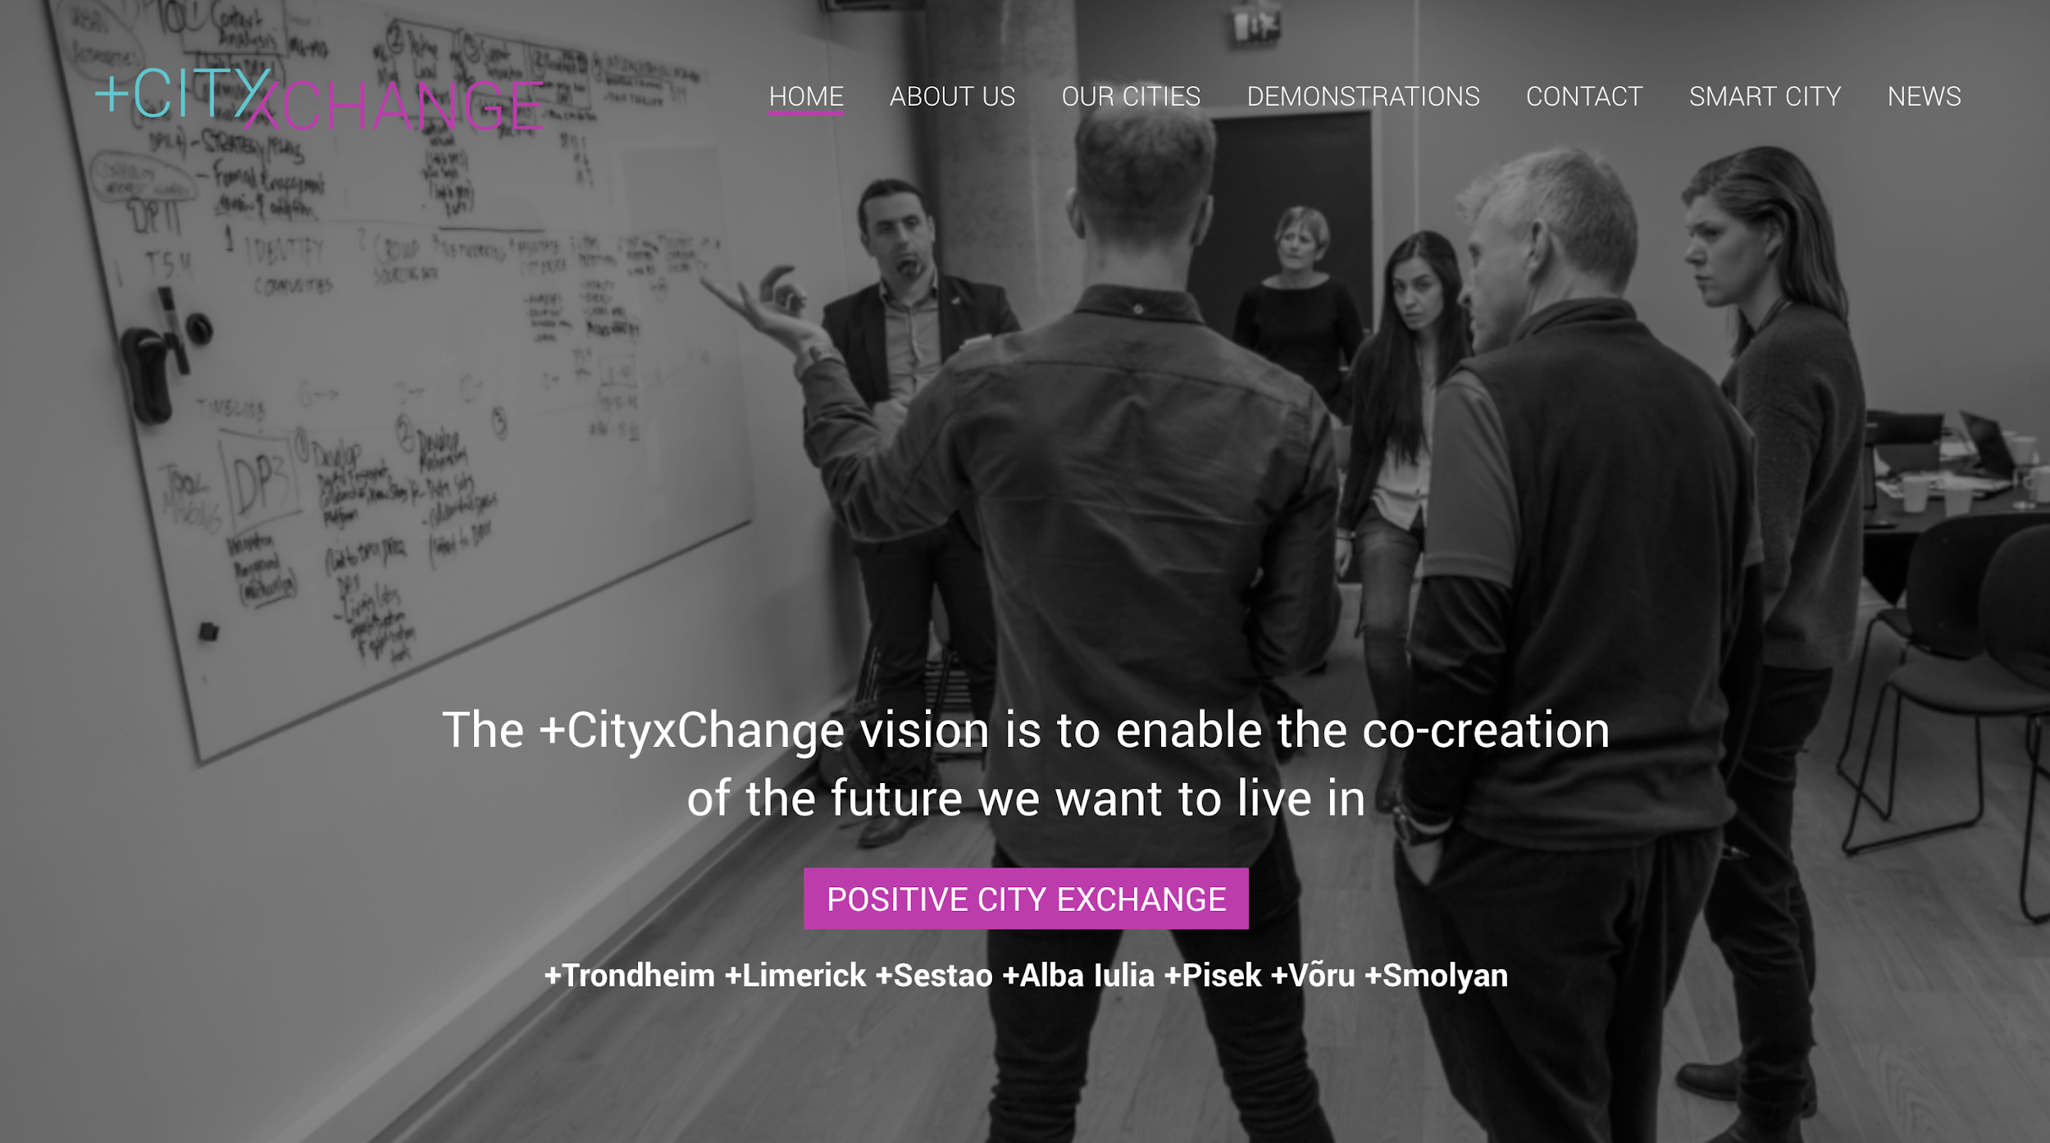

Slide 10
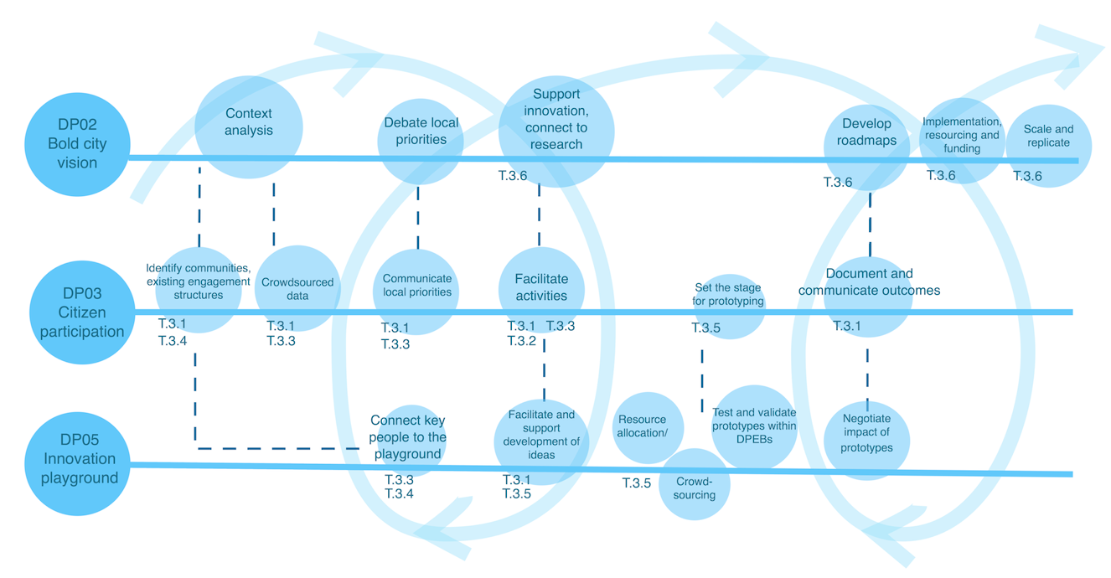
Citizen Participation Processes

Slide 11
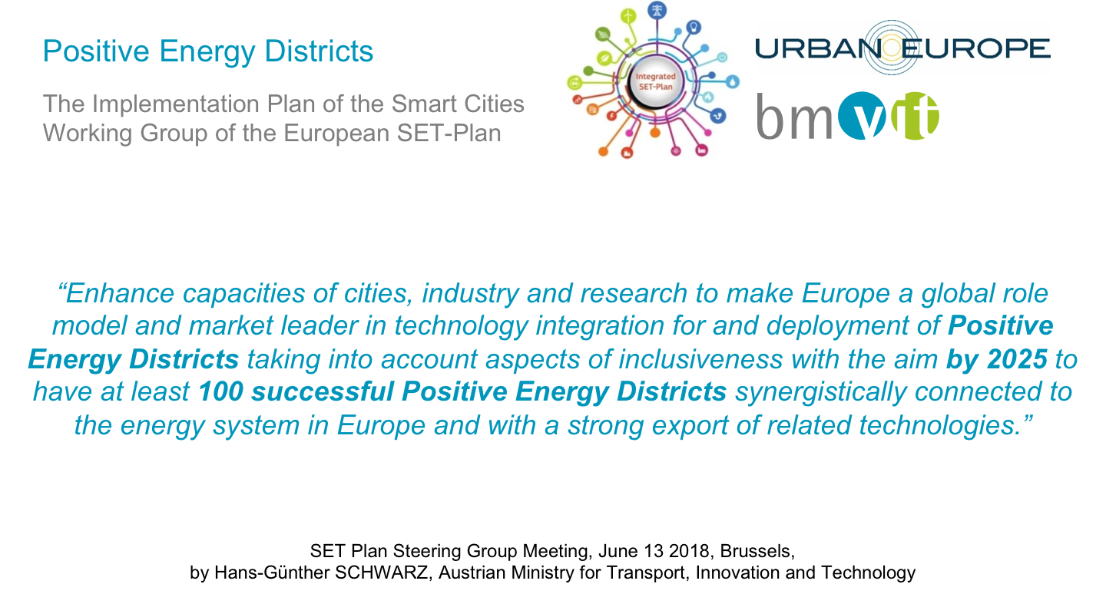

Slide 12
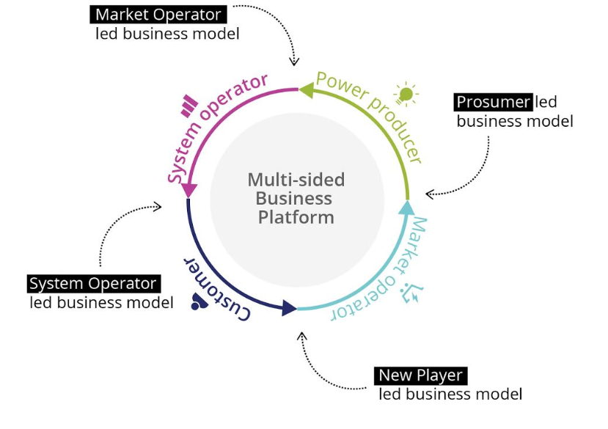
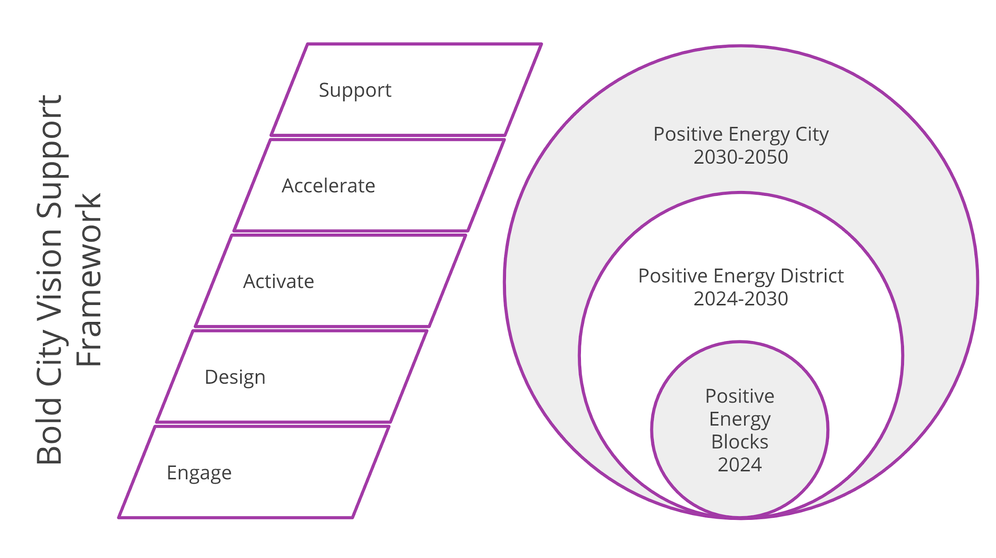
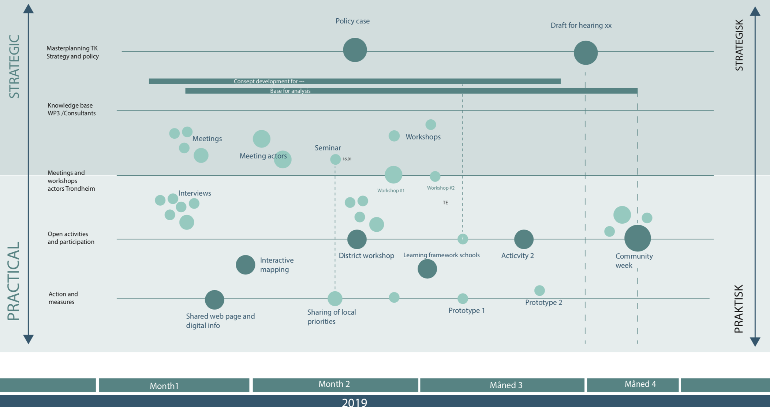
Achievements so far
Started one of the first large-scale projects on Positive Energy Blocks/Districts
Frameworks developing
Bold City Vision strategies
Engagement methods
KPI Framework
Operational PEB definition
Citizen Observatories
Workshops
Open Collaboration

Slide 13
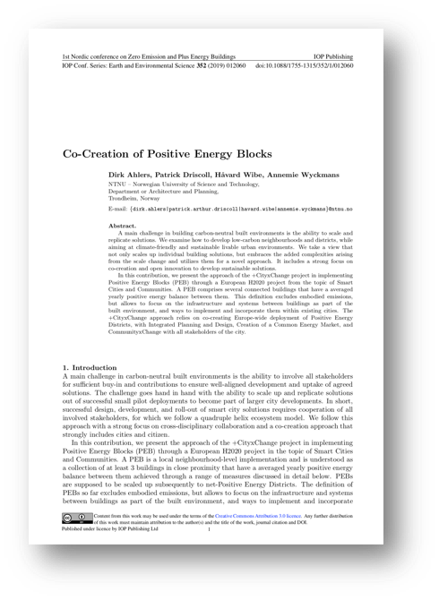

Q&A
Dirk Ahlers
dirk.ahlers@ntnu.no
https://www.ntnu.edu/smartcities
Patrick Driscoll,
Håvard Wibe,
Annemie Wyckmans
Website: cityxchange.eu
Twitter @plusCities
Mail: info@cityxchange.eu
Published under CC-BY4.0 Creative Commons Attribution, except where otherwise noted. https://creativecommons.org/licenses/by/4.0/
Notes:
We were talking about 3 things above. We promise also 3 things: 1) Fights, 2) Insane amounts of work, 3) Lots of fun

Slide 15
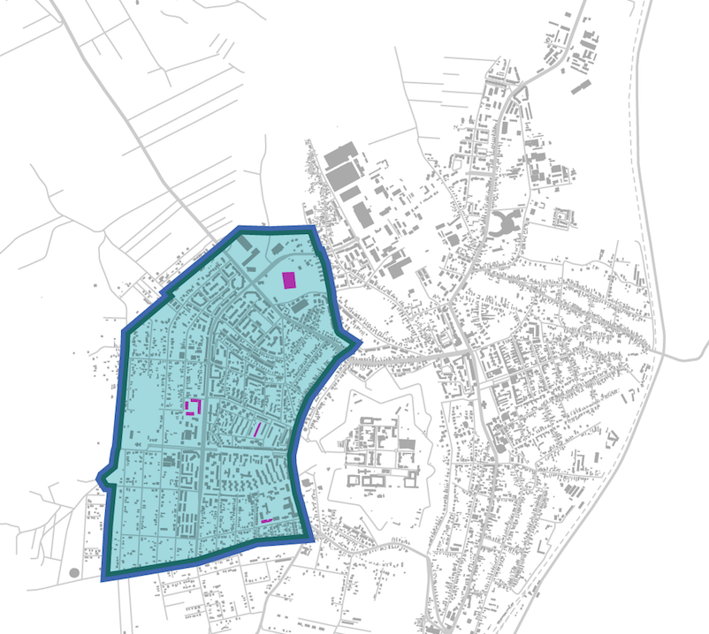
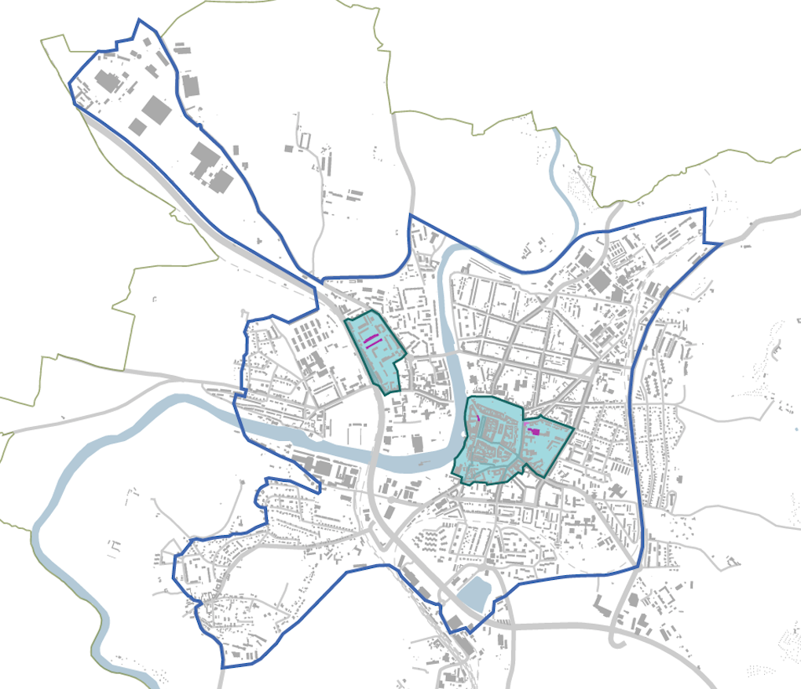
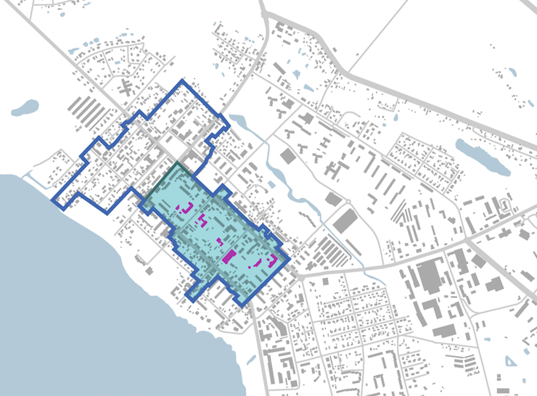
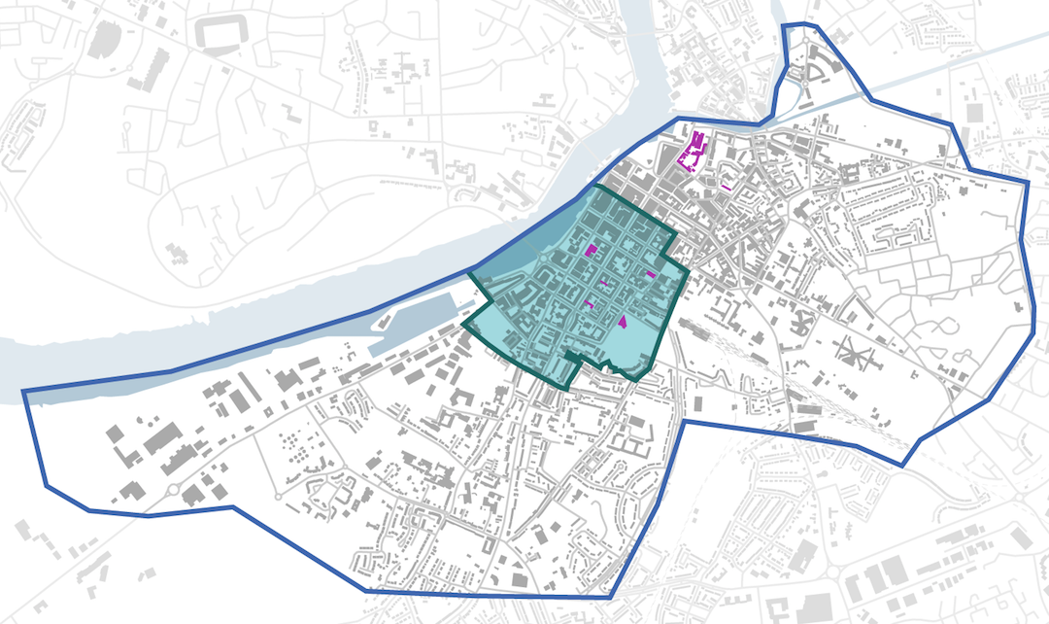
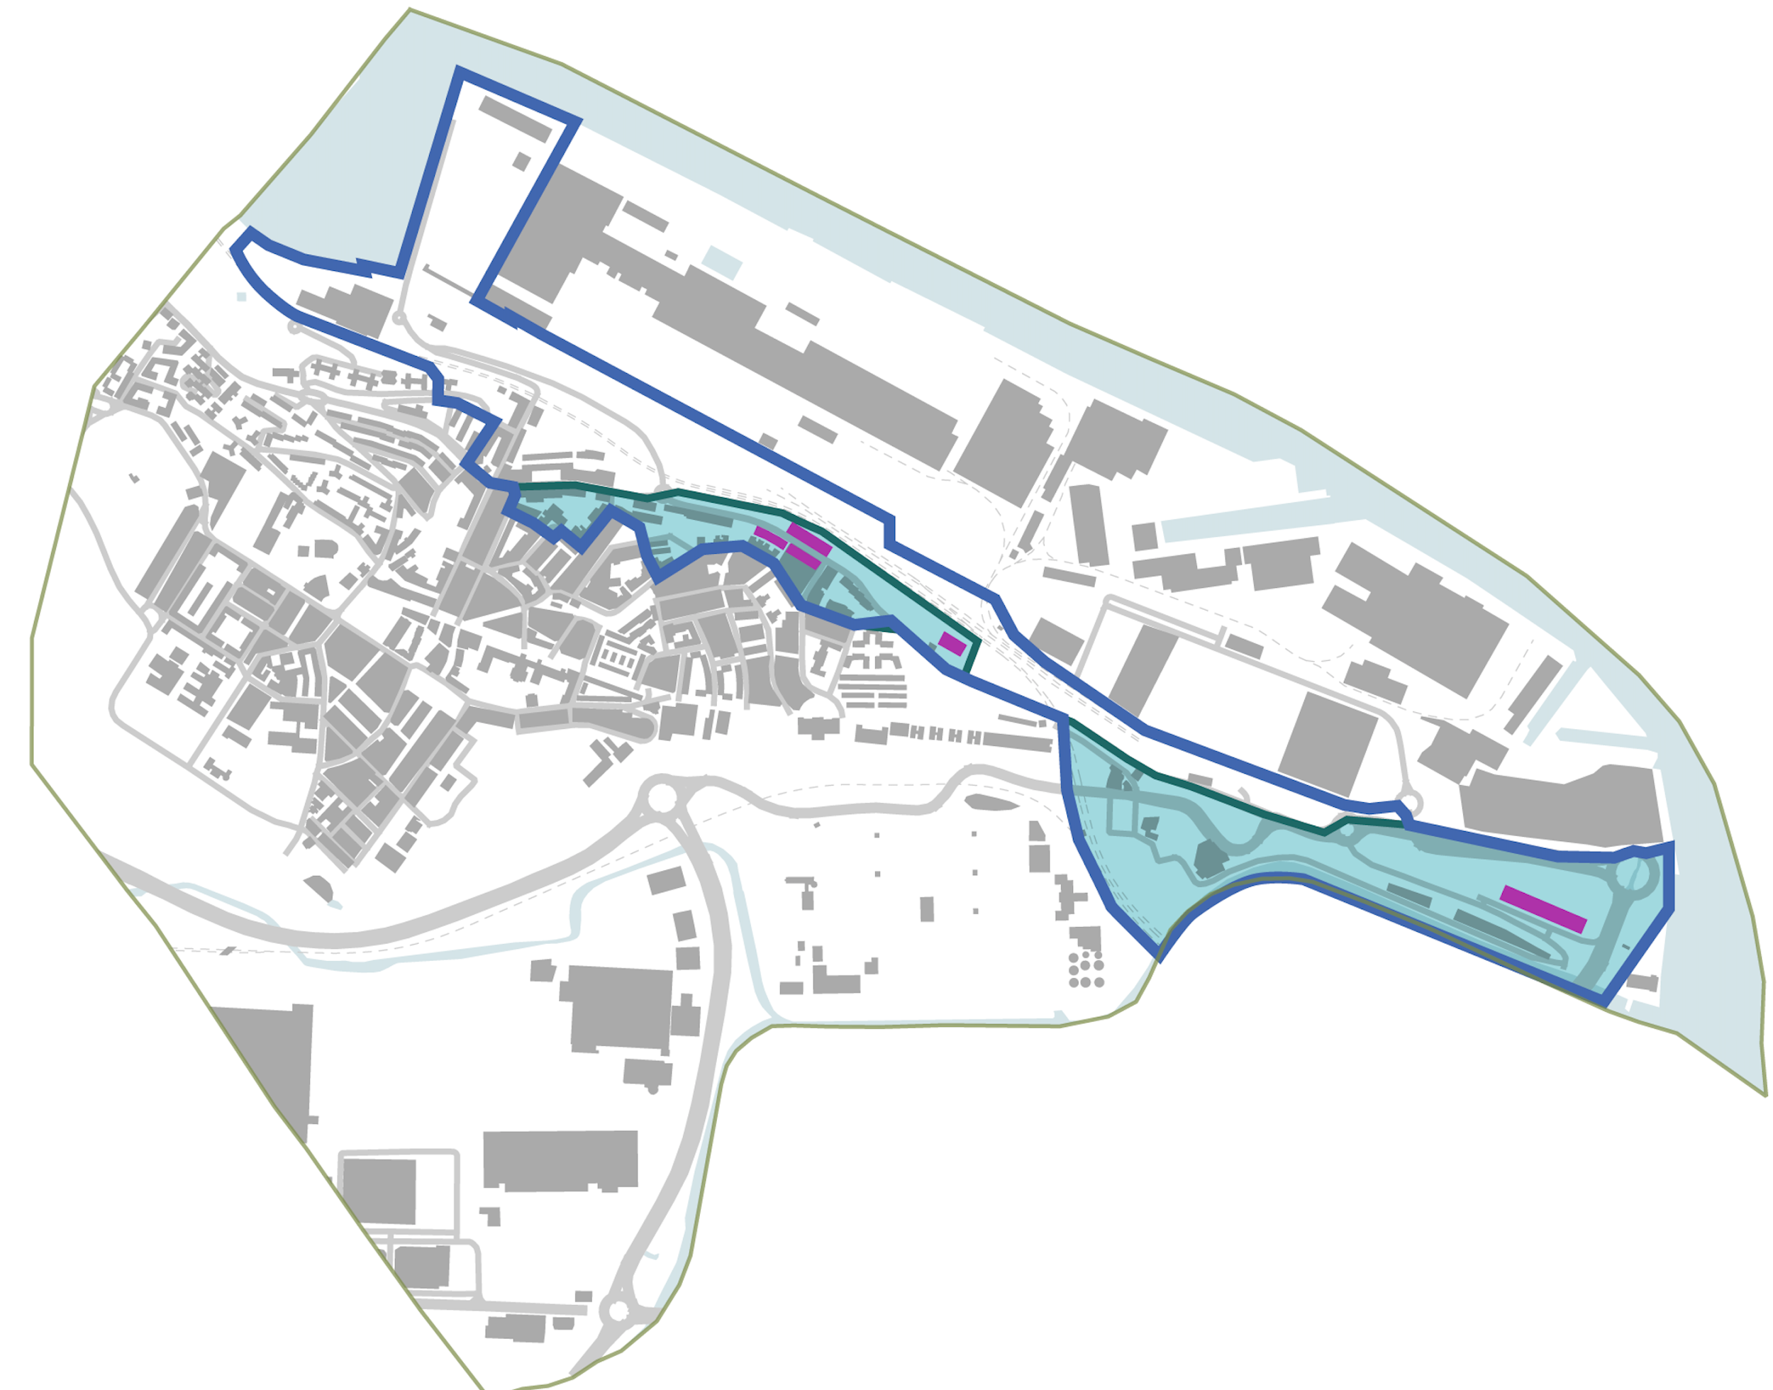
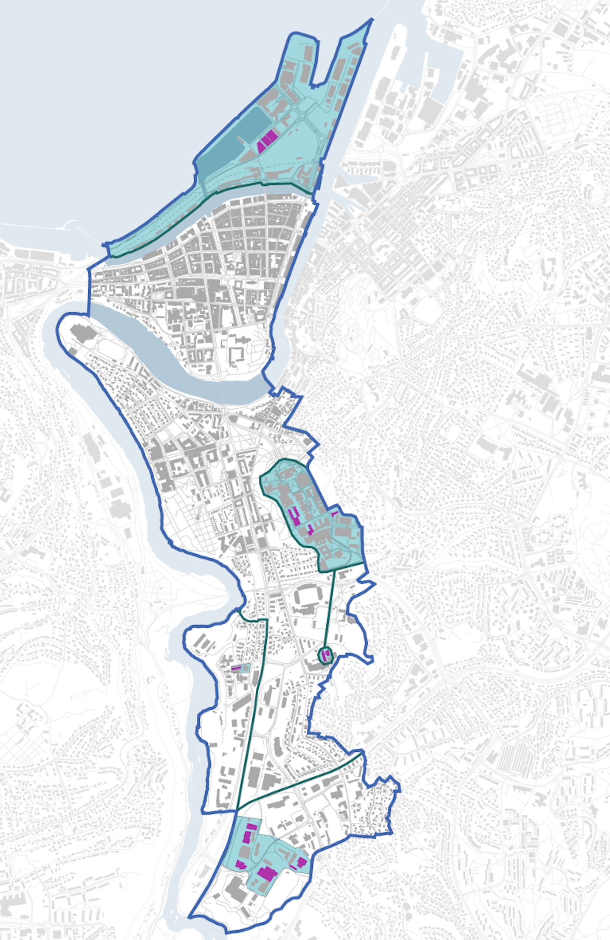
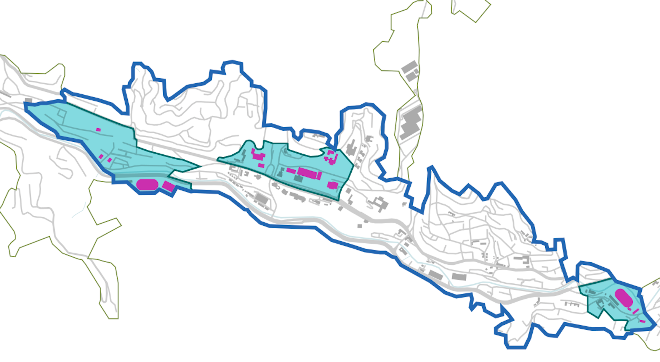

Slide 16
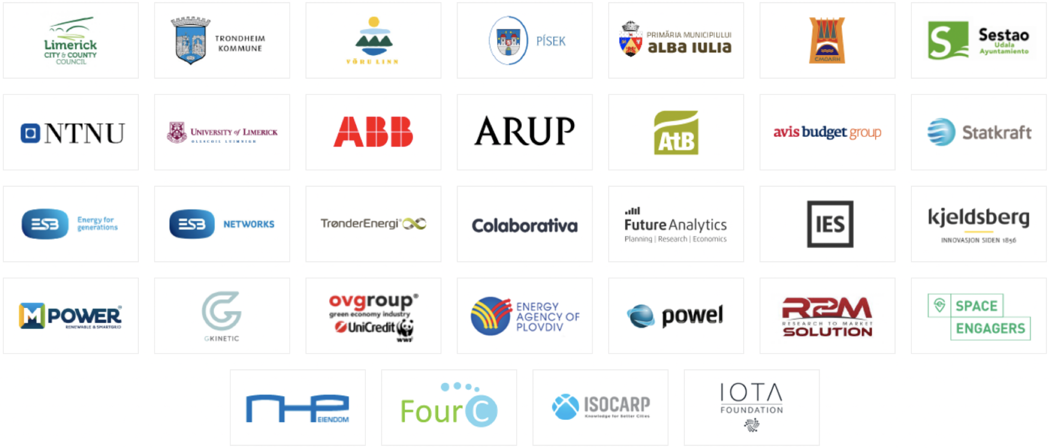
Consortium

Slide 17
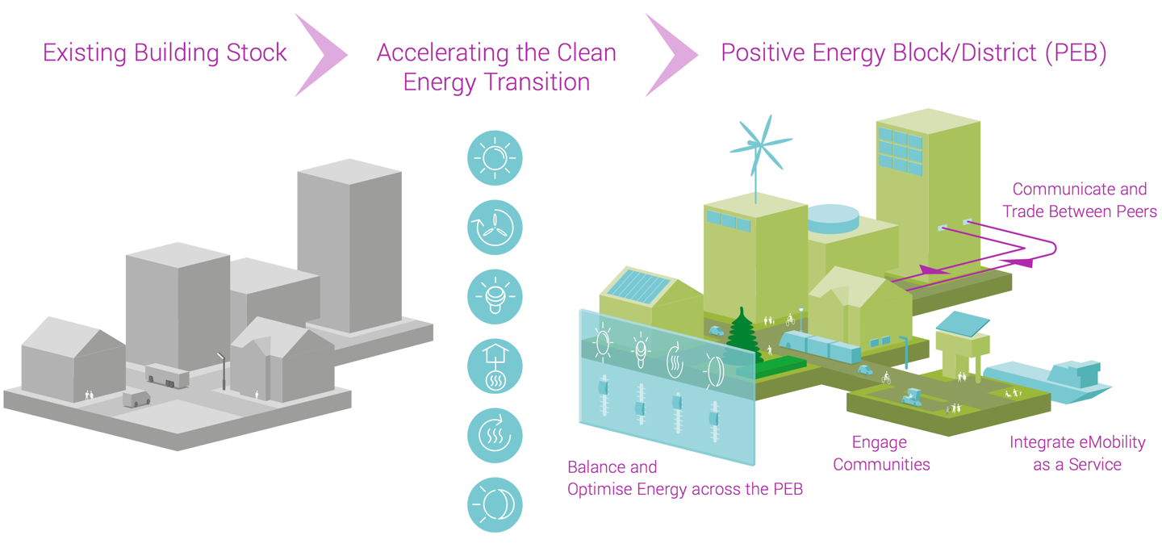
City-Driven System Transition towards PEBs/PEDs

Slide 18
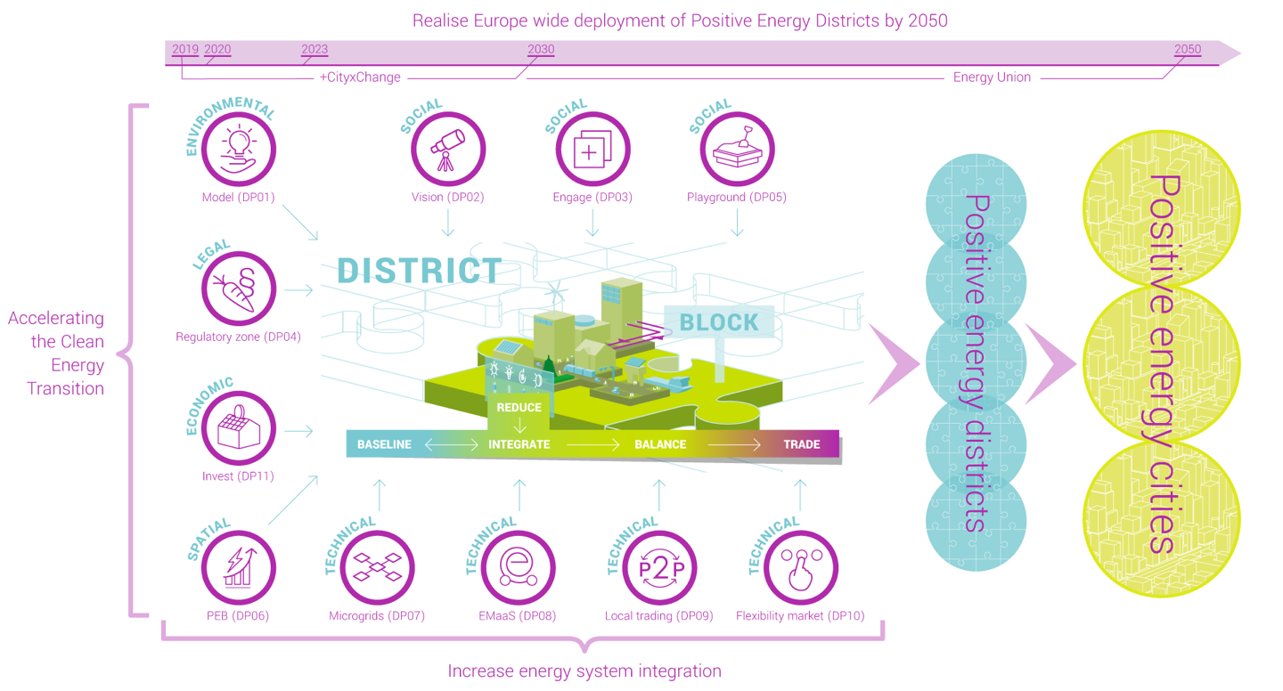
Scaling

